Slide 1






E-COMMERCE SALES ANALYSIS
Student Details
NAME: MANJU M
NM ID: au612821105011
COLLEGE NAME: VARUVAN VADIVELAN INSTITUTE OF TECHNOLOGY

Slide 2
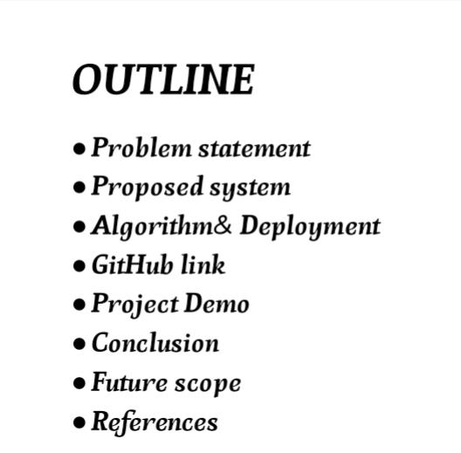

E-Commerce Sales Analysis

Slide 3
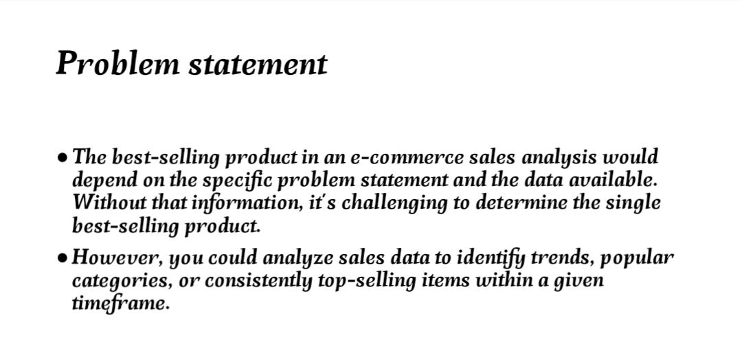


E-Commerce Sales Analysis

Slide 4
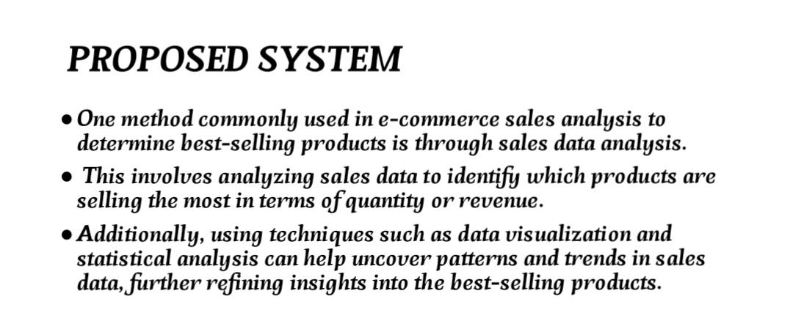


E-Commerce Sales Analysis

Slide 5
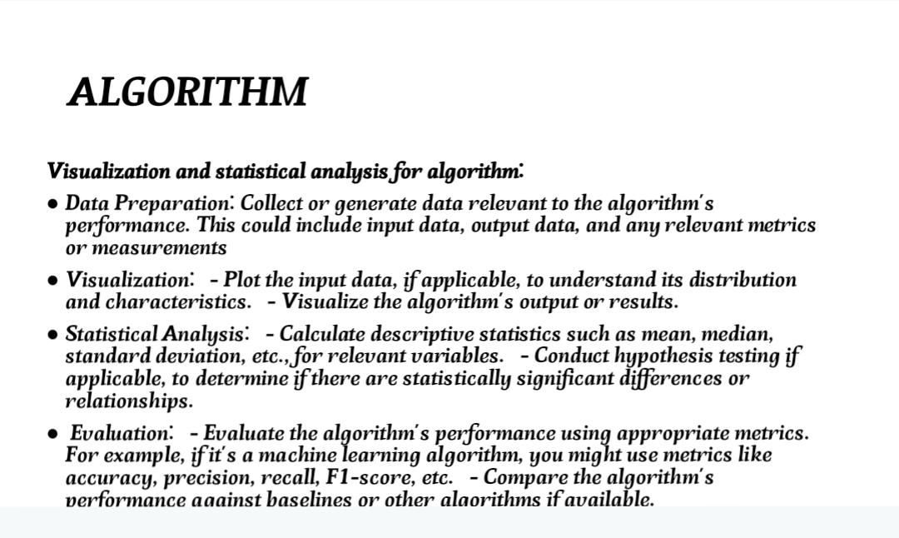

E-Commerce Sales Analysis
Aim and Objective

Slide 6
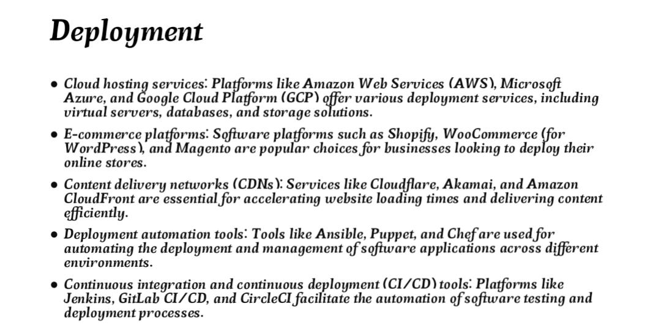
E-Commerce Sales Analysis

Slide 7
E-Commerce Sales Analysis
GITHUB LINK :
https://github.com/EEE5011manju
Notes:
7

Slide 8
E-Commerce Sales Analysis
PROJECT DEMO
https://github.com//EEE5011manju_E-commerce
Notes:
8

Slide 9
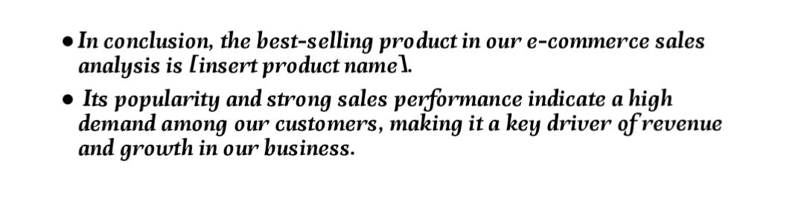

E-Commerce Sales Analysis
CONCLUSION :
Notes:
9

Slide 10

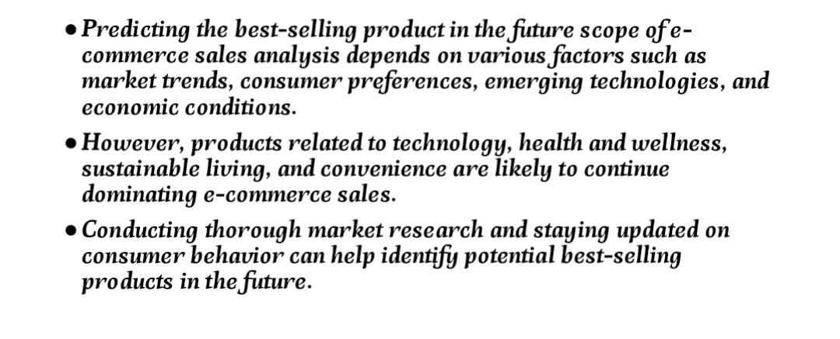
E-Commerce Sales Analysis
Future Scope
Notes:
10

Slide 11
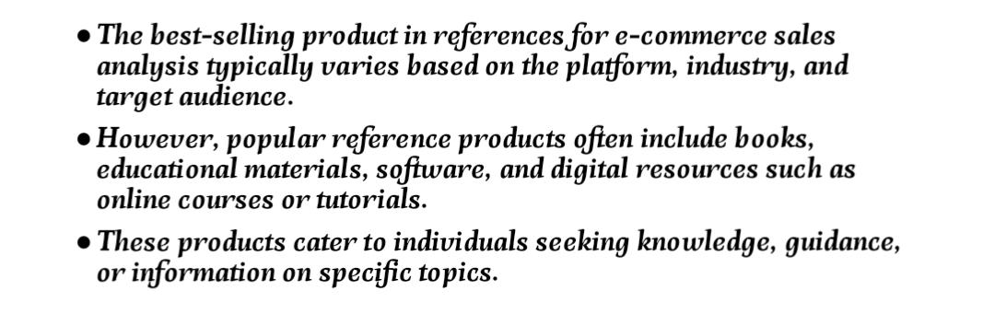
E-Commerce Sales Analysis
REFERENCS
Notes:
Reference
These are the references for this session.

Slide 12
E-Commerce Sales Analysis
Thank you!
Notes:
12

